Slide 1
Detecting Disaster from Tweets

Slide 2
Presented by
“Abdelrahman Mohamed Soliman”
Supervised by
“AMIT”

Slide 3
Introduction
Social media applications such as Twitter and Facebook are fast becoming a key instrument in gaining situational awareness (understanding the bigger picture of the situation) during disasters. This has provided multiple opportunities to gather relevant information in a timely manner to improve disaster response.

Slide 4
Keywords
Dataset has 5 columns. Column “target” is the label column which means I am going to train a model that can predict the value of column “target” using other columns such as “text”, “location” and “keyword”. Now first let’s understand what each column means:
id - a unique identifier for each tweet
text - the text of the tweet
location - the location the tweet was sent from (may be blank)
keyword - a particular keyword from the tweet (may be blank)
target - in train.csv only, this denotes whether a tweet is about a real disaster (1) or not (0)

Slide 5
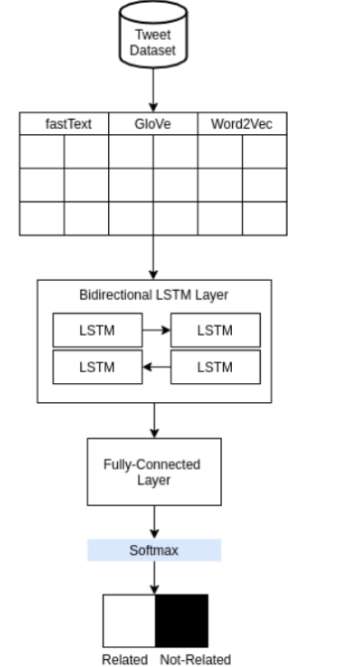
Flow Chart
Activation function

Slide 6
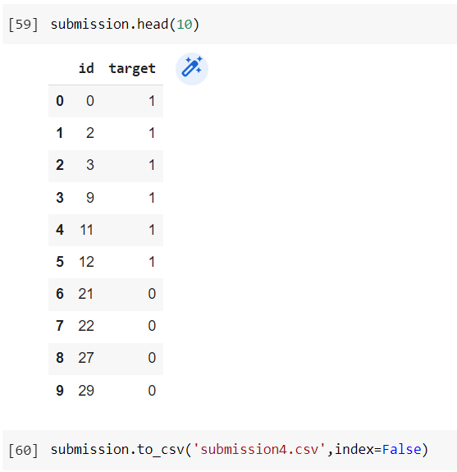
Results

Slide 7
Thank You

